Slide 1
CIS387/ECE387
Digital Forensics I
Hard Disk Drives, Solid State Drives, and Disk Partitions

Slide 2
Reading
Chapter 5: Guide to Computer Forensics and Investigations, by Bill Nelson, Amelia Phillips, Christopher Steuart.

Slide 3
Today’s Objectives
How data is stored and managed on Microsoft OSs
Understanding disk drives
Understanding partitions
Understand Microsoft boot process
  DOS boot process
  Windows boot process
Notes:
Study how data is stored and managed on Microsoft operating systems.
To become proficient in recovering data for computer investigations, we need to understand file systems and their Oss.

Slide 4
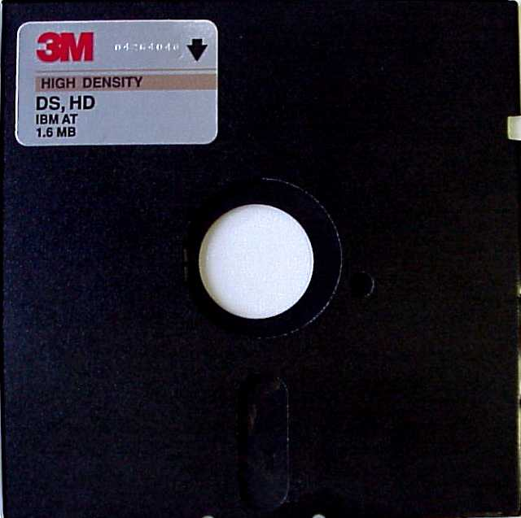
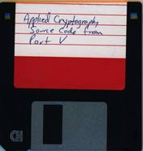
Floppy Disks
Yes these still exist!
By 2010, computer motherboards were rarely manufactured with floppy drive support
Originally single sided
Then became double sided
5.25
3.5
Notes:
8-in, 5.24 in and 3.5 in
The head gap of an 80-track high-density (1.2 MB in the MFM format) 5 ¹⁄₄-inch drive
3 ¹⁄₂-inch floppy disk were produced with a capacity of 720 KB, followed by what became the most common format, 1.44 MB.
Originally, we had to boot OS from a floppy disk drive; then take out floppy disk and load another disk, which contained a program we could run.

Slide 5
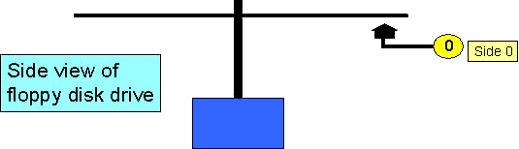
Side View of Floppy in Disk Drive
Single-sided Disk
0
Side 0
Disk Drive
Original floppies were single-sided
Notes:
Original floppies were only formatted on one side, the bottom. They could store 160K of data.
The sides of the disk are numbered starting with the number zero.
On a floppy, side 0 is on the bottom. This is the standard configuration so that a floppy disk could be used in drives from different manufacturers.

Slide 6
FD Densities & Capacity
Disk Size | Density | Sectors/Track | Capacity
5.25 | Low | 9 | 360K
5.25 | High | 15 | 1200K
3.5 | Low | 9 | 720K
3.5 | High | 18 | 1,440K

Slide 7
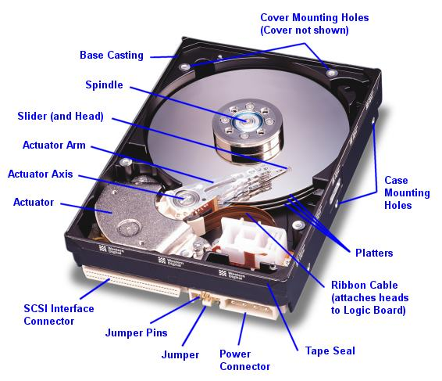
Hard Disk Structure (magnetic storage, just like floppy discs)
Hard disk drives are organized as a concentric stack of disks or ‘platters’
Each platter has 2 surfaces
How a hard disk works?
  The platters rotate on the spindle
  The heads move along the radius of the platters
  This allows the head to access all parts of the surfaces
Notes:
Disks spin at about 7200 RPMs!

Slide 8
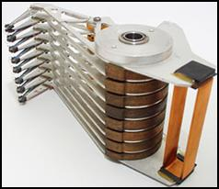
HD Elements
16 heads
8 Platters
Notes:
Moving r/w head to correct cylinder (track) == seek time (this is what gives the disk most of its slow speed).
Also rotation time contributes to disk r/w speed.
Once you are on a certain cylinder, the time to read 1 sector on that cylinder is about the same as reading many sectors on that SAME cylinder
When you jump around to read sectors from different cylinders, this is what causes slow speed (r/w head has to move).
Then r/w transmit time (the least significant amount of time).

Slide 9
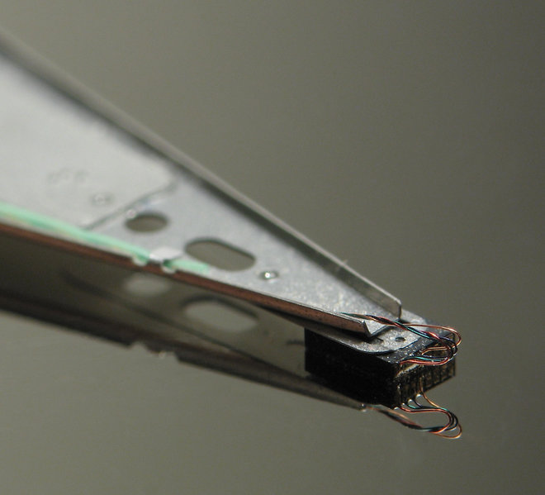
HD Head
Each platter has a planar magnetic surface on which digital data may be stored
Information is written to the disk by transmitting an electromagnetic flux through read-write head (an antenna) that is very close to the magnetic material

Slide 10
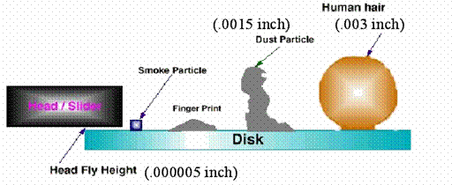
HD Head Clearance
Notes:
The distance between the read/write head and the surface of the hard drive(head fly/floating height) is so small that a strand of human hair will not pass between them.
•Hard drives rotation speed depends on the specific model. Typical speeds are 5,400 RPM, 7,200 RPM, and 10,000 RPM.
•Hard drives were originally coated with ferrous oxide (rust), similar to the coating on audio tapes. Modern drives have some form of “thin film magnetic media”, which allows for closer placement of the read/write heads and allowing more data to be written to the disk (areal density).
RPM: Revolutions Per Minute

Slide 11
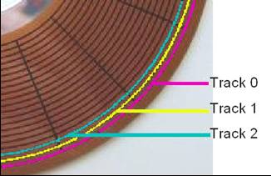
How Data is Organized on HD - Tracks
The data is stored on concentric circles on the surfaces known as tracks
Numbering starts with 0 at the outermost of the disk

Slide 12
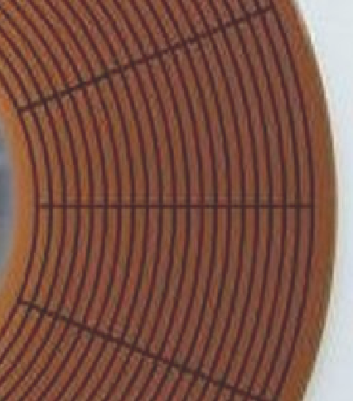
How Data is Organized on HD - Sectors
A sector is a continuous linear stream of magnetized bits occupying a curved section of a track
Sectors are the smallest physical storage units on a disk- Each sector stores 512 bytes of data
Numbering physical sectors within a track starts with 1
Sector 2
Track 0
Sector 1
Track 0
Notes:
Thus, even if you only want to update a single, at a minimum, an entire sector (512 bytes) must be updated.
Usually, when reading, we read in entire blocks at a minimum (because of caching techniques to speed up a computer).
The outer most tracks have more sectors than inner tracks (inner tracks have smaller circumference) because sector length is always the same no matter what track you are on.

Slide 13
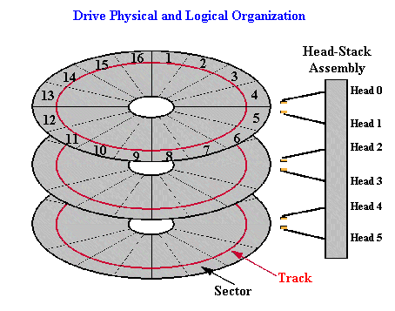
How Data is Organized on HD - Cylinders
Head Stack Assembly
CYLINDER
Head 0
Head 1
Head 2
Head 3
Head 4
Head 5
Track
Sector
Corresponding tracks on all platter surfaces make up a cylinder
On a floppy diskette, the pair of tracks that lie over/under each other are also called a cylinder
Notes:
The same organizational structure of sectors, tracks, cylinders and heads that exists on floppy disks also exists on a hard disk. A hard disk will have multiple platters and thus more heads or sides which comprise a cylinder. Track 0 on side 0, 1, 2, 3, 4, and 5 together make up cylinder 0 since they are vertically aligned.
The slide displays a simplified representation of the hard disk structure, but things are considerably more complicated than this.

Slide 14
Exploring Microsoft File Structures -Cluster
In Microsoft file structures, sectors are grouped to form clusters (blocks)
  Storage allocation units of one or more contiguous sectors
The smallest pieces of storage that an OS allocates for a file
  Combining sectors minimizes the overhead of writing or reading files to a disk
Clusters are typically 512, 1024, 2048, 4096, or more bytes each
  Total number of sectors per cluster is always a power of 2
Number of sectors per cluster varies according to the size of the drive and the version of the file system
Notes:
Minimum unit to allocate to a file is one block (cluster) = 512 bytes.
Each block is 2^i sectors, where a sector is 512 bytes; i could = 0, thus making block and cluster size the same size; but typically, block size is larger than 1 sector.
Majority of files are actually very small, how do we handle this?
Typically the larger the drive, the larger the sector size

Slide 15
LAB 1 HINTS
Sudo dd if=/dev/sbd←(usb)
Nc -1 8888 > datacopy.dd
Kill -9 pid
Rm –rf datacopy.dd

Slide 16
Drive Slack
Microsoft OSs allocate disk space for files by clusters
  Results in drive slack
    Unused space in a cluster between the end of an active file and the end of the cluster
Drive slack includes:
  RAM slack
    Unused space on a sector
    Filled with data pulled from RAM
      May contain sensitive info such as logon ID, password
  File slack
    Unused space on a cluster
Notes:
Example: write(to sector#, from memory buf, 492 bytes)
Remember smallest size we write to disk is 1 sector = 512 bytes (or whatever sector size is).
Minimum file size in windows is 32KB

Slide 17
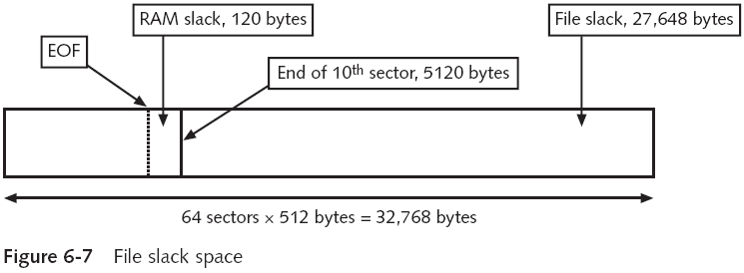
Drive Slack (continued)
Notes:
Shown above is 1 cluster = 32 KB
File size in example is only about 10 sectors (5120 bytes); thus 64-10 = 54 sectors are not being used, but minimum size to allocate for a file is 64 sectors.
Those 54 unused sectors are called “file slack” (this slack space is likely space that was deleted and over written a long time ago, but there can be some previous file that was large enough to be written on that part of the cluster because it required more sectors).
We call it file slack because that is the space where another file was previously written
The other 120 bytes shown above is RAM slack because minimum write size is 512 bytes, so if file size is small enough, you need to still write 512 bytes, so sometimes the OS will pull information from RAM in order to write junk data to make up the rest of the 512 byte write operation.
This is due to physical limitation; some OS will 0 the remaining sector space during a write; but they probably use RAM because it may be faster to write in information from already-charged capacitors rather than 0 out (discharge) unused sector space during a write operation.

Slide 18
Hard Disk Addressing
Older BIOSes in PC’s used 24 bit addressing which could only access up to 8.4 GB (2²⁴ * 512 bytes).
Newer BIOSes can access 64 bits of addressing, which equals 9.4 Tera Gigabytes, or over a trillion times as large as an 8.4 GB drive.

Slide 19
C H S Addressing
Work for disks less than 8GB
Each storage unit on a disk is identified by a 3-coordinate system identifying the
  Cylinder
  Head/Side
  Sector
One method of calculating disk capacity is to multiply the number of cylinders, heads, and sectors (i.e. CHS) together, and then multiply by the sector size of 512 Bytes.
Notes:
IDE (Integrated Disk Electronics)
Extended IDE (EIDE).

Slide 20
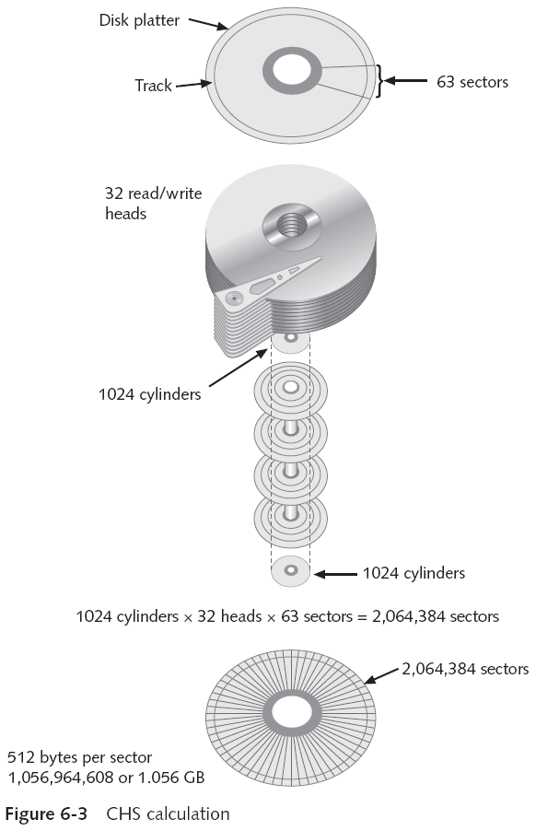
Addressable bytes on a disk
using CHS calculation
Notes:
Note: the reason we do not need average cylinder size (for this particular disk technology) is because they are the same size; how is this possible when outer cylinders have larger area/circumference than inner cylinders? Because they are designed such that the outer disks have less sector density than inner disks – such that all cylinders have the same number of sectors.
For newer technology disks: all disks have same sector density such that each cylinder does not have the same number of cylinders.

Slide 21
Hard Disk Addressing (Cont.)
Most Intel based mother boards use an ATA (Advanced Technology Attachment) interface which connects to the hard disk - IDE disk
The BIOS will read the disk’s cylinders, heads, and sectors through this interface, and, depending on the size of the disk and the BIOS settings, to determine the size of the disk and how it should be accessed.
Notes:
IDE (Integrated Disk Electronics)
Extended IDE (EIDE).

Slide 22
LBA – Logical Block Addressing
By industry agreement, large IDE disks (with more than 16,514,064 sectors) will return c=16383, h=16, s=63, for a total of 16514064 sectors (7.8GB) independent of their actual size, and LBA capacity
LBA is a linear addressing scheme; blocks are located by an integer index, with the first block being LBA 0, the second LBA 1, and so on.
CHS Conversion
  Sector number, specific to a logical disk drive
Sector: c, h, s
LBA(c, h, s) = ((c*HPC)+h)*SPT+s-1
HPC: total num of heads per cylinder
SPT: total num of sectors per track
Notes:
It is up to disk controller to find out where a disk address is located (not up to OS anymore for modern systems).
It is best that OS does not handle this in order to read/write faster from a disk (have it hardware pre-programmed and controlled by disk controller).
Also disk controller can handle all bad sectors and hide them from the OS (totally hidden from OS).
We have s-1 so that if CHS = 001, so that LBA= 0.

Slide 23
Host Protected Area (HPA) and Device Configuration Overlay (DCO)
User Addressable Sectors
HPA
DCO
IDENTIFY_DEVICE
READ_NATIVE_MAX_ADDRESS
DEVICE_CONFIGURATION_IDENTIFY

Slide 24
Host Protected Area (HPA)
The HPA (an acronym for Host Protected Area and also known as the Hidden Protected Area) is an area of a hard drive or solid-state drive that is not normally visible to an operating system.
  It was first introduced in the ATA-4 in 2001.
  Computer manufacturers may use the area to contain a preloaded OS for install and recovery purposes (instead of providing DVD or CD media, have recovery image in HPA)
Notes:
Note, this must mean that when you reimage a computer: the disk drive where OS is stored to be booted from is reformatted logically with the new file system of the OS being installed.

Slide 25
Device Configuration Overlay (DCO)
The Device Configuration Overlay (DCO), which was first introduced in the ATA-6 standard
It "allows system vendors to purchase HDDs from different manufacturers with potentially different sizes, and then configure all HDDs to have the same number of sectors.
For example, using DCO to make an 80-gigabyte HDD appear as a 60-gigabyte HDD to both the (OS) and the BIOS.
  Given the potential to place data in these hidden areas
Notes:
See note from last slide: you may need to hide 20GB of data as shown in the example above, because if you are an IT system admin, with many different kinds of machines with various disks and disk sizes, it will be more convenient to reimage hundreds of machines with one configuration image and not have to worry about nuances of differing disks/disk sizes.
Whenever you reimage a disk, logically the drive must be reformatted because the entire file system is replaced (with file system of new image).

Slide 26
Summary of Hard Disk
Data on a HD are stored on tracks
Corresponding tracks on all surfaces make up a cylinder
Data is written in sectors and usually read in clusters
A storage unit can be identified by CHS
LBA is used for drives larger than 7.8 GB
Notes:
HDD are still the most cost effective way to store large amounts of data (even data centers still use them).

Slide 27
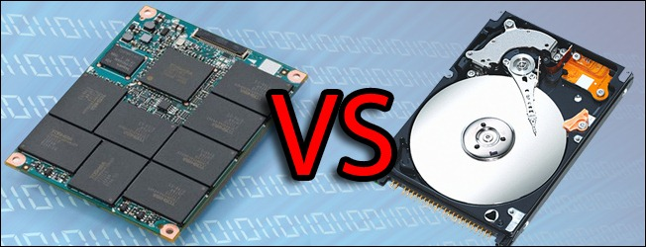
Solid-State Drives
A solid-state drive (SSD) uses integrated circuit assemblies to store data persistently, typically using flash memory, and functioning as secondary storage in the hierarchy of computer storage.
Compared with the electromechanical drives, SSDs are typically more resistant to physical shock, run silently, and have quicker access time and lower latency.
Notes:
Also SSD use much less energy (no mechanical moving parts and constant spinning of disks which cost a lot of electrical energy).

Slide 28
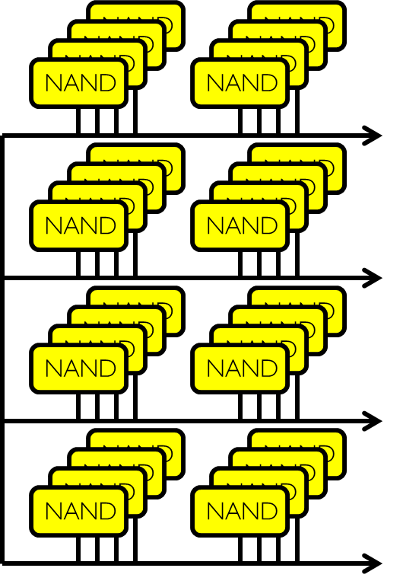
SSD Architecture – Reads
Host
Buffer
Manager
(software
Queue)
Flash
Memory
Controller
SATA
DRAM
  Read 4 KB Page: ~25 usec
  No seek or rotational latency
  Transfer time: transfer a 4KB page
Notes:
READ ACCESS TIMES (WORST CASE)
Access of SSD is very similar to RAM access method, but not as fast as DRAM (100ns = 0.1us read speed); CPU register takes <1ns.
For HDD it can be up to 10ms = 10,000us = the slowest read speed.

Slide 29
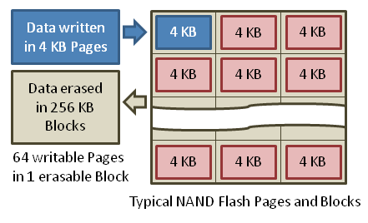
SSD Architecture – Writes
  Writing data is complex! (~200μs – 1.7ms )
  Can only write empty pages in a block
  Erasing a block takes ~1.5ms
  Controller maintains pool of empty blocks by coalescing used pages (read, erase, write), also reserves some % of capacity
Rule of thumb: writes 10x reads, erasure 10x writes
https://en.wikipedia.org/wiki/Solid-state_drive
Notes:
For HDD, read/write speed is about the same.
For SDD, you cannot overwrite; must erase first before writing (this can have an impact on digital investigations because often in background OS will take idle time to quietly erase unallocated/marked for deletion rive space so that write operations can have a higher chance of being faster by increasing chances that a selected block is erased already).
Note: when you do an erase, you have to erase an entire block (not just a single page), this can cause additional overhead because minimum file size is 4KB, so if you need to erase an entire block, you may have to move some pages that are allocated on that block to another block so that you can do the erase operation.

Slide 30
Advantages
Reliability in portable environments and no noise
  No moving parts
Faster start up
  Does not need spin up
Extremely low read latency
  No seek time (25 microsecond per page/4KB)
Deterministic read performance
  The performance does not depend on the location of data
High performance flash-based SSDs generally require half to a third of the power of HDDs.
Notes:
HDD is not deterministic for read performance: depends on location of data on disc and if you are doing random or sequential access→ seek time + rotation + transmit time → will determine read/write speed.
For example, if head is already on correct track (cylinder), then read/write time is almost 0.
For SDD, it is a circuit-based memory, so it is consistent for random and sequential access (HDD has an advantage over SDD for sequential operations, but SDD as stated is deterministic no matter what read/write access being done and overall has faster performance → but if you needed to do mostly sequential writing and reading, then HDD could be a better option on that argument among others).
SDD can use half or up to 1/3 the power of HDD because it has no mechanical/moving parts.

Slide 31
Disadvantage
Cost significantly more per unit capacity
Limited write erase time (similar to how battery cells have limited number of times you can charge them)
  100000 writes in each cell for SLC=single bit cells (MLC=multi-bit cells is even fewer)
  high endurance cells may have an 1-5 million
Slower write speeds because of the erase blocks are becoming larger and larger(1.5 ms per erase)
Less expensive SSDs typically have write speeds significantly lower than their read speeds. Higher performing SSDs have similar read and write speeds.
SSDs based on NAND Flash will slowly leak charge over time if left for long periods without power.
Notes:
When you write to a SSD, you have to charge the cells in order to write bits to it which takes time (and so that it is not volatile when power is lost); SSD is basically a battery.
This is why it can be bad for long term storage (especially without power).

Slide 32
Solid-State Drives
Rewrite requires blocks to be erased electronically before they can be used again.
  vs ‘write-over-old-data’ property of magnetic tapes and disks
    Garbage Collection technology built into SSD controllers automatically reset the data blocks back to free space
    Most manufacturers use TRIM, an OS-based command for cleaning up “garbage” files
  This will affect rebuilding evidence after garbage collection has taken place?
Notes:
Remember, in general, SSD is faster than HDD.
Also remember, for SSD; we read and write in pages (usually page size matches that of size of actual physical RAM memory; typically 4KB).
SSD speeds:
Read = 25 microseconds
Write = about 10x the amount of time as read
Erase = about 10x the amount of time as write
Remember: We erase (not overwrite, but actually zero-out, thus data is truly lost) in blocks (1 block = 64 pages), so that sometimes we have to move pages because SSD can only erase by blocks.
This can make collecting evidence harder after garbage collection takes place
For HDD: We simply mark blocks as deleted, and also we can overwrite (only when marked for deletion blocks are overwritten is the data officially lost).

Slide 33
Solid-State Drives
All flash memory devices have a feature called wear-leveling
  An internal firmware feature used in solid-state drives that ensures even wear of read/writes for all memory cells (for example, some cells that are written to often can be marked read only and its data moved to another part of the disk; but this can mean you will lose more and more useable space from the original available size when you first got the disk).
When dealing with solid-state devices, making a full forensic copy as soon as possible is crucial
  In case you need to recover data from unallocated disk space
Notes:
Remember this concept shown above (wear-leveling) from Operating System course CIS-450.
Cells die when they are written to too many times; cells can only be written to approximately 100,000 times.
So, reading from SSD cells does not really produce wear (you can read as often as possible – basically no limit); its primarily the writing (and thus erasing before writing) of the cells that causes the wear because of charging and discharging
For SSD, because you have to move data around for erases and for even wearing (due to writing) of cells, you want to use only about 2/3 of the drive space capacity.
For HDD, you can use closer to full space capacity of the drive because of its different design (also because of overwrite feature of HDD and because you do not need to charge cells but change only directions of charges, HDD has longer life span).

Slide 34
Objectives
Understanding disk drives
Understanding partitions
Understand Microsoft boot process
  DOS boot process
  Windows boot process

Slide 35
Disk Partitions
Many hard disks are partitioned
  Usually, a partition is a logical drive
FAT12 does not recognize disks larger than 2 MB
  Large disks have to be partitioned
On Windows and DOS computer systems, partition information is stored in Partition Table inside Master Boot Record (MBR)
  Stored on the first sector of a disk
  Contains boot code, partition table, a signature value
Notes:
Signature value: last two bytes are 0x55 and 0xAA of the MBR sector (if in first sector).
Usually MBR is in first sector, but if first sector is damaged, it can be moved; so if you scan sector by sector until you find signature value, then you will know where the MBR is located.

Slide 36
Partition Table
Have 4 entries
  64 bytes long
  Each entry is 16 bytes long
Valid entries contain essential information about the partition
  Starting and ending CHS (Cylinder, Head, Sector) address
  Starting LBA (logical block address) address (24 bits = 3 bytes)
  Number of sectors in partition
  Type of partition (FAT, NTFS (Windows), EXT (Linux)…)
    You can have multiple partitions on the same physical drive, with each partitions formatted for a different OS (i.e., one partition could be NTFS=Windows OS boot code and file system, another partition formatted with EXT=Linux OS boot code + file system)
  Bootable Flags (single bit: true or false → is system bootable?; if yes, then jump to the MBR of the logical drive that you check for bootability
Notes:
Each table entry describes the layout of a partition in both CHS () and LBA addresses.
A partition table is 64 bytes long. An entry in the partition table is 16 bytes long. There is room for 4 entries in a partition table, but not all entries have to be used. Normally, if an entry is not being used, that entry will contain all 0’s. In order for the BIOS or an operating system to recognize a partition, it’s entry must contain recognizable, valid information.
The term “Active partition” refers to the primary partition that is designated as such in the Master Partition Table. During the boot process, the partition table is examined to identify the active, primary partition, and code redirects the boot process to the first sector of that partition. To be actually used to boot the system, it must also contain the necessary system files.
There can only be one active partition, and only a primary partition may be marked active.

Slide 37
Extended Partition Concept
MBR only have 4 entries, need more than 4 partitions
Extended partition
  Use 1~3 entries in the MBR for normal partitions and then create an “extended partition” that will fill up the remainder of the disk
  More partitions are allowed on the extended partition
Normal partition #1
Normal partition #2
Normal partition #3
Extended partition

Slide 38
Why Care about Partitioning?
Important Point: When examining a suspect’s hard drive, why is it necessary to know how it's partitioned?
Notes:
Reasons to examine the partition tables:
To look for multiple operating systems
To look for hidden partitions
To make sure all space on the drive is accounted for.

Slide 39
Partitioning
Reasons to examine the partition tables:
  To make sure all space on the drive is accounted for
  To look for multiple operating systems (i.e., if you have a x86 architecture computer, you can run some Mac OS, Windows OS, Linux OS).
  To look for hidden partitions

Slide 40
Hidden places due to partitions
Partition gap
  Unused space between partitions
    Leave space between partitions
    At the end of a disk by declaring smaller number of bytes than the actual drive size
Hidden partition (average user won’t be able to know what’s going on and find/see the data).
  Changing pointers in partition table
  Changing type in partition table

Slide 41
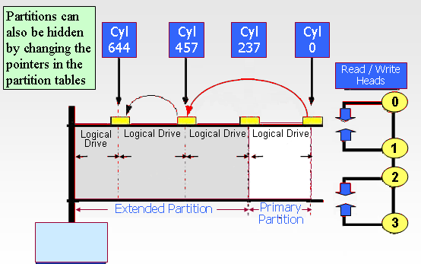
Hidden Partitions
Changing pointers in partition table
This partition disappears!
Notes:
We can locate the hidden partitions using:
Use MBR (master boot record) signature and VBR signature (volume boot record)
First you do partition (logical formatting of the drive), then you install file system on each partition: so, even though you change pointer and data of one partition that was created disappears (from redefining the partition), the file system only know the original boundaries for its logical drive (partition), so it will not overwrite into the hidden partition.

Slide 42
Hidden Partitions
Changing type in partition table
Windows will not mount a file system in a partition if it does not support the partition type
  Example:
    A disk has a FAT file system inside a partition with a Linux file system type
    A user will not see the FAT file system from within Windows
    Solution: change type (logically/temporarily so we can see it), or use a tool that will allow you to see all partitions at the partition level.

Slide 43
Partition Tools
To view hard disk at the partition level,
Norton DiskEdit
WinHex
Partition Table Doctor

Slide 44
Low-level (Factory) Format
Step 1: Use a low-level format program to create a magnetic structure of sectors
One 512-byte sector
Low-level formatting is usually done at the factory.
Low-level formatting establishes the communication, or hand-shaking, between the drive and its controller.
Notes:
The first step in initializing a drive is a low-level format. Drives are normally low-level formatted at the factory and cannot be low-level formatted by the local dealer or the consumer without special software.
Older model drives (MFM, ST-506, etc.) could be low-level formatted by the local dealer or knowledgeable user. Low-level formatting establishes the communication, or hand-shaking, between the drive and its controller.
The most commonly used low-level format creates sectors that contain 512 bytes of data storage area.

Slide 45
Results of Low-level Format
The sectors are organized by tracks
All the sectors on one track
The low-level formatting process works cylinder by cylinder. This minimizes the amount of head movement required during the format process.
Notes:
The low-level formatting process works cylinder by cylinder. This minimizes the amount of head movement required during the format process.

Slide 46
Initializing a Hard Drive with FDisk
Step 2: use a high level formatting tool such as FDISK to create partition and file systems
(by default, MBR is at cylinder 0, head 0, sector 1 (first CHS); rest of first track (track = cylinder) is reserved for future use)
MBR
Reserved
Reserved
Master Boot Record
  Master Boot Code
  Master Partition Table
Reserved
Reserved
Reserved
The remainder of that track is “Reserved”
Reserved
Reserved
Notes:
Using FDISK, we first create a primary partition which contains logical drive C. This partitioning information is stored in the Master Partition Table in the Master Boot Record (MBR), located at cylinder 0, head 0, sector 1. Any primary or extended partition will be defined here. The entire remainder of that track is reserved, by DOS. Normally, no other information is written there.
The partition table data is stored in the Master Boot Record, which is contained in the 1st sector of cylinder zero, head zero.
The remaining sectors on that track are reserved.
Data may only be written to this space by using a disk editor program that will access the space. Some software programs, such as disk encryption or password protection software, may also read and write to the reserved area, but these applications were specifically designed to bypass the operating system. DOS does not utilize this space.
Some special software packages, such as disk encryption or password protection software, may use some of that reserved area for special purposes. However, to date, DOS has not utilized that space.
Master Boot Code
This is a very small program that transfers control to whatever boot program is in the active (i.e. startable) partition. In many systems this would be the OS/2 Boot Manager.

Slide 47
Overview
Understanding disk drives
Understanding partitions
Understand Microsoft boot process
  DOS boot process
  Windows boot process

Slide 48
Understanding Microsoft Boot Process
Need to have a good understanding of what happens to disk data at startup
  Any access to a computer system alters disk evidence
  Incorrect access can make the digital evidence corrupt and less credible for any litigation
Especially, we want to learn what files are accessed when Windows starts
  This information helps you determine when a suspect’s computer was last accessed
    Important with computers that might have been used after an incident was reported
Notes:
A good understanding of what happens to disk data at startup. In some investigations, you must preserve data on disk exactly as the suspect last used

Slide 49
Understanding the Boot Process
System boot process
  A series of steps that the system performs when it is turned on
  Always starts with the special boot program software in the system BIOS ROM (or BIOS Flash; ROM is replaced with Flash nowadays, so that BIOS/UEFI (unified extensible firmware interface) can actually be updated; of course this is very dangerous if BIOS is corrupted)
  After BIOS has completed its startup activities, OS is loaded
  Computer stores system configuration and date and time information in the CMOS when power to the system is off
    BIOS uses CMOS information to initialize the boot process
Notes:
ORDER: BIOS→MBR of a given disk/disk partition (from partition table)/other drive media or even from the network (download boot code over network) (depends on boot order)→VBR of the file system of the drive (physical or logical) we booted from →load OS from that same drive/location we booted from.

Slide 50
Understanding the Boot Sequence (continued)
  CMOS should be modified to boot from a forensic floppy disk or CD
  Booting from hard drive may destroy evidence on hard drive
Accessing CMOS depends on the computer’s BIOS (varies by different manufactures; try one of the following after you are already in BIOS)
  Delete
  Ctrl+Alt+Insert
  Ctrl+A
  Ctrl+S
  Ctrl+F1
  F2
  F10

Slide 51
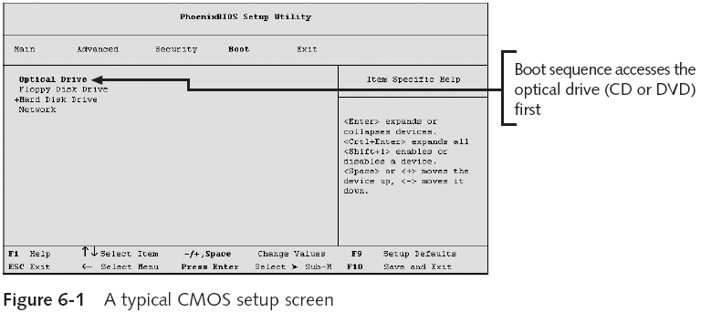
Understanding the Boot Sequence (continued)

Slide 52
Review of HD (hardware) Boot Sequence (DOS)
power on self test (POST) by BIOS
master boot record
extended partition?
No
Yes
load extended partition tables
volume boot code of c:
DOS

Slide 53
DOS Hard Drive Boot Sequence (1)
Power is on
CPU ready to run, but run what?
The BIOS performs the Power On Self Test (POST)
  RAM, keyboard, other subsystems
  POST for any device that has a BIOS
    Video card, network card, other devices
Notes:
This process tests memory as well as a number of other subsystems. You can usually monitor this as it runs each test. After that is complete the system will run POST for any device that has a BIOS (Basic Input-Output System). An AGP has its own BIOS, as do some network cards and various other devices.

Slide 54
DOS Hard Drive Boot Sequence (2)
Once POST is complete, BIOS is secure that everything is working properly
BIOS then reads MBR, loads the boot code, and transfers control to it
  The MBR is always located at cylinder 0, head 0, and sector 1
  The MBR contains
    Master Partition Table – this small table contains the descriptions of the partitions that are contained on the hard disk
    Master Boot Code
Master boot code
  a small initial boot program that the BIOS loads and executes to start the boot process
  Since the master boot code is the first program executed in RAM when you turn on your pc, this is a favorite place for virus writers to target (viruses on MBR was especially common in floppy disk days when people shared floppy disks from which to boot from).
Notes:
Even your BIOS could be infected with root kit malware that can compromise the BIOS of a system which will be hard to remove (but this is very rare).

Slide 55
DOS Hard Drive Boot Sequence (3)
The master boot code examines the master partition table
  To determine if there is an extended DOS partition
    Load the extended partition table
  To determine if there is a primary bootable partition
    Boot from that partition
Load volume boot sector (drive C) and the boot code in it is given control
Notes:
The Master Partition Table points to the active primary partition (usually the C: Drive). The system then looks on that logical drive for the Boot Record, which identifies the operating system and points to the next file to be loaded, which is IO.SYS.

